Slide 1
Accelerating Windows Vista Deployment Projects with Windows Vista Solution Accelerators
Jeremy Chapman – Deployment and Management
Baldwin Ng – Assessment
Russ Humphries – Security
Solution Accelerators
Microsoft

Slide 2
Agenda
Solution Accelerators
Windows Vista Solution Accelerators Suite
  What is it and how does it work?
Components
  Windows Vista Hardware Assessment
  Microsoft Deployment
  Windows Vista Security Guide
  Windows Vista Service Life-Cycle Management
Q&A

Slide 3
The Scenarios Covered
Interested in determining hardware readiness and upgrade costs for Windows Vista migration.
Customer interested in desktop
deployment planning services.
Customer wants to ensure clients and data are secure prior to deploying the new OS.
Customer wants to minimize TCO and properly manage the desktop service.

Slide 4
Solution Accelerators
Help IT Pros
  Solve specific scenario problems
  Get the most out of Microsoft technology
  Get where they want to be faster
  Build effective and efficient IT systems
Drive
  Accelerated Adoption
  Customer satisfaction
  Partner enablement
  Product improvement

Slide 5
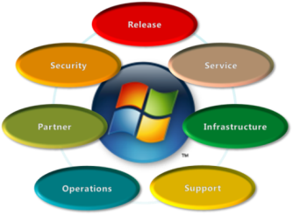
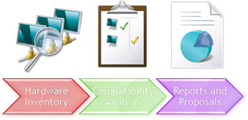


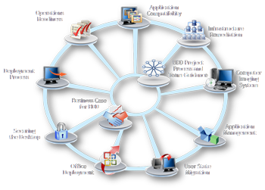
Windows Vista Accelerators
Service Management
Assess
Windows
Vista Service
Life-Cycle Management
Windows Vista Hardware
Assessment
Secure
Windows Vista Security Guide
and Data
Encryption Toolkit
Microsoft
Deployment
Deploy

Slide 6
Minimum Requirements
Goal to move at least to the Core IO Standardized level
Around 250 or more networked PCs*
Windows Server 2003
Active Directory*
Has or plans for Group Policy in place
Tools for software distribution or patching
* Some solution accelerators such as the Windows Vista Hardware Assessment can be used by customers with less than 250 PCs and without Active Directory.

Slide 7
Scenario 1
Interested in determining hardware
readiness and upgrade costs for
Windows Vista migration.

Slide 8
Understanding Hardware Specs
Hardware Compatibilities
  System memory
  CPU Speed
  Hard Drive Capacity
Device Compatibilities
  Source of drivers
  BIOs black list, etc
Imagine analyzing thousands of PCs manually!

Slide 9

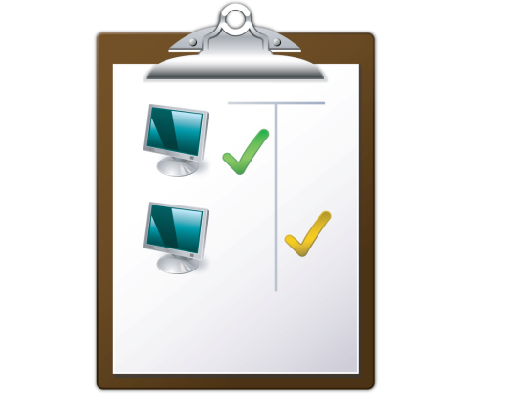
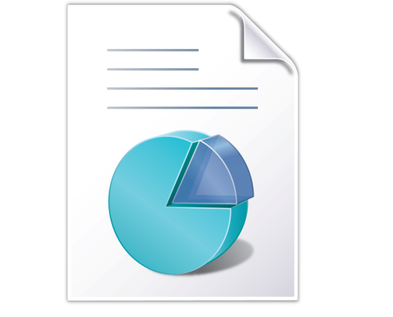
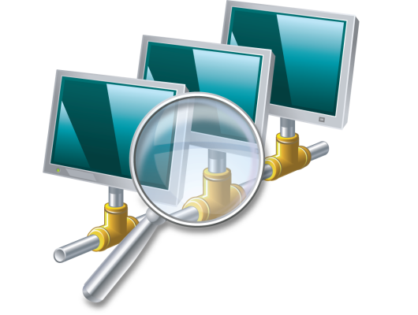

Windows Vista Hardware Assessment
No software agents; no concerns
PC readiness assessment in hours instead
of days!*
Hardware
Inventory
Compatibility
Analysis
Reports and
Proposals
*Current version of this tool is optimized to scan 25,000 computers per domain/workgroup.
**Technologies do not currently allow agent-less detection of BitLocker/TPM and AeroGlass attributes.

Slide 10

Why Windows Vista
Hardware Assessment?
Benefits
  Identifies computers quickly that are ready for Windows Vista and
  2007 Microsoft Office on the network
  Simplifies desktop migration planning
  Provides detailed information to help determine the right Microsoft
  Volume Licensing option
Features
  Quick and agentless hardware and device driver inventory of up to
  25,000 PCs per domain/workgroup for every scan
  Detailed Windows Vista and Office 2007 compatibility analysis on hardware/devices
  Comprehensive readiness reports with actionable recommendations
  for each PC
“[Results from the Windows Vista Hardware Assessment reports] saved us more than U.S.$20,000; we just need to upgrade the memory and hard drives for many of our clients. The cost of upgrades is much cheaper than replacing an entire computer.”
—Kathy Lin, IT Manager of Sporton International, Inc., Taiwan

Slide 11
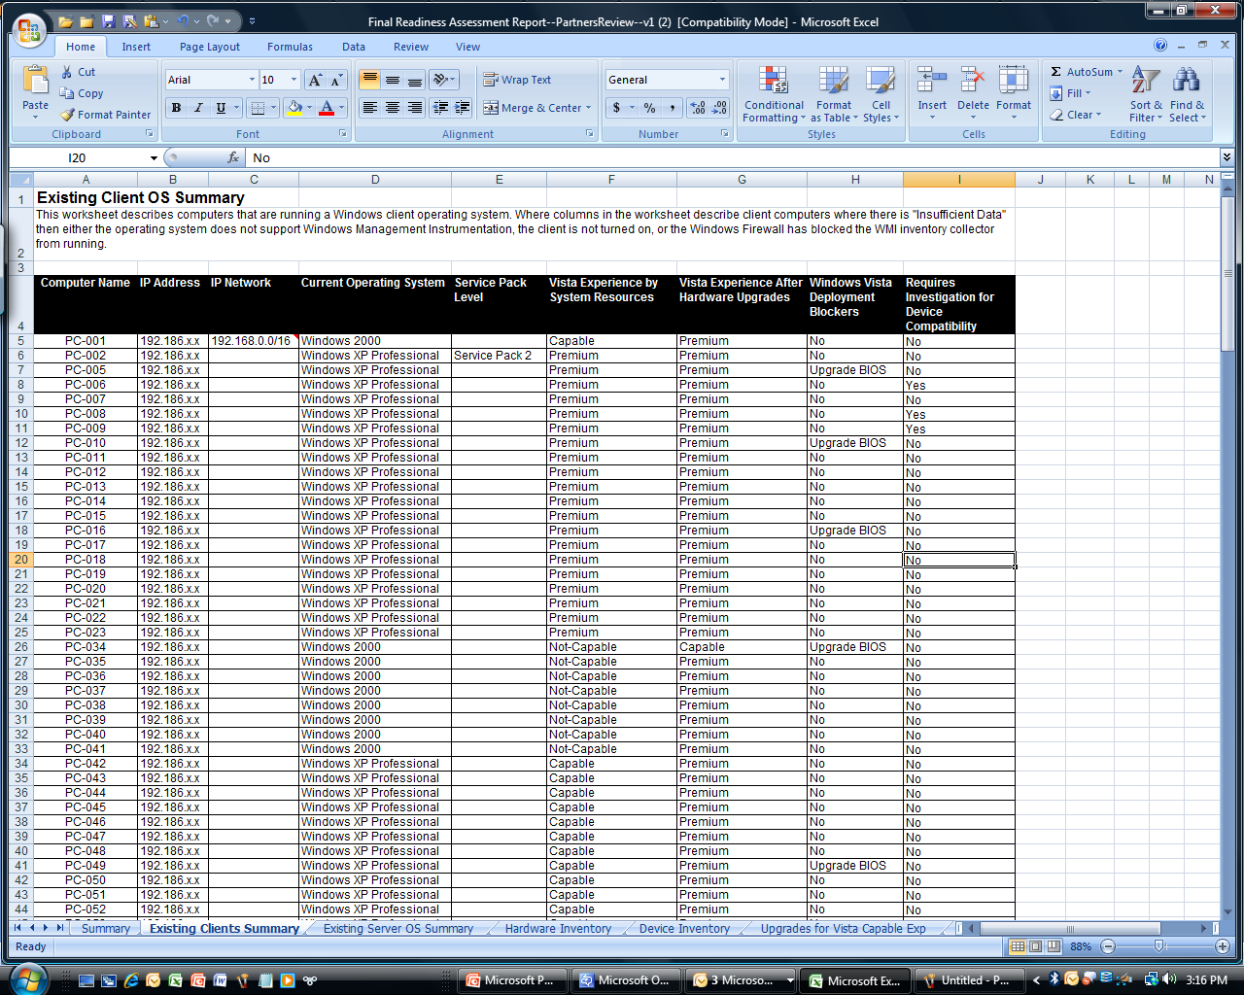
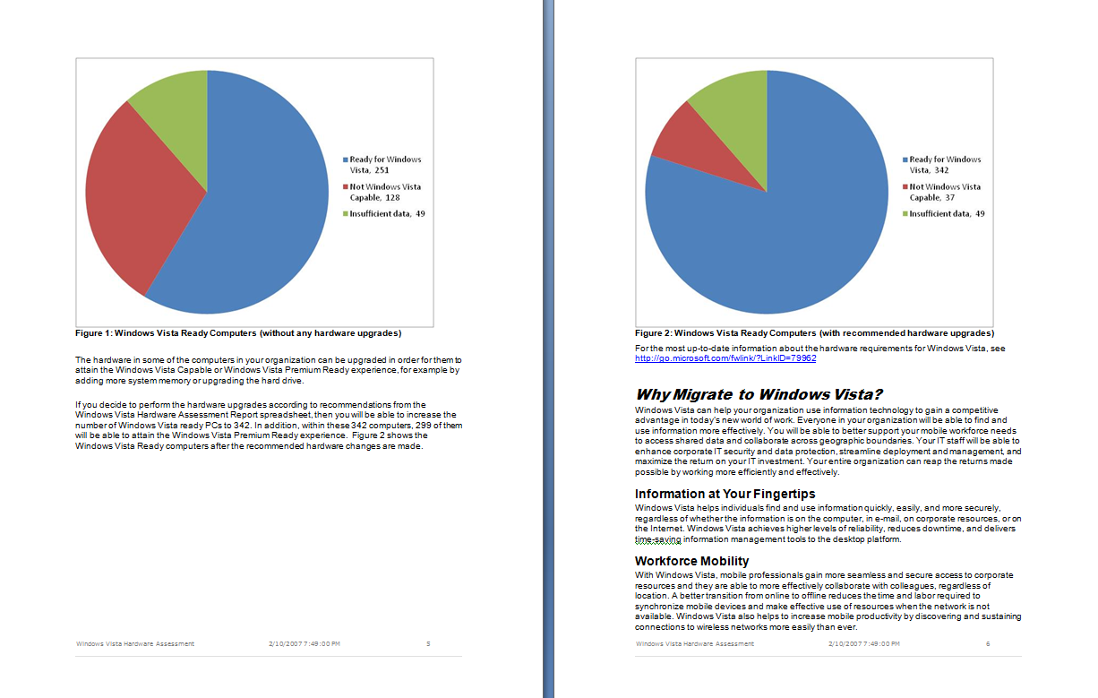

Detailed Report (Microsoft Excel)
Summary Report (Microsoft Word)
PC-by-PC Level Detailed Reporting
Current OS Results
Hardware and Device
Assessment Results
System Resources
Experience after Upgrades
Deployment Blockers
Device Compatibility
Notes:
11/12/2007 4:34 PM

Slide 12

Windows Vista Hardware Accessment
demo
Baldwin Ng
Solution Accelerators
Microsoft

Slide 13
New Features
WVHA v2.1 (available now!)
Scalable to larger networks
  Up to 25,000 PCs per domain/workgroup in every scan
  Multiple scans can be done to assess larger networks with
  more than 25,000 PCs
Capable to target select number of computers
  OU-targeting within Active Directory
  Flat-File Import of Computer Names
  IP range targeting
Ability to assess for 2007 Microsoft Office
Offer non-Windows computer discovery via SNMP
Localized to 6 new languages, readiness reports in
  French, German, Japanese, Korean, Latin American Spanish,
  and Brazilian Portuguese
Download Windows Vista Hardware Assessment at
http://www.microsoft.com/technet/wvha

Slide 14
Scenario 2
Customer interested in desktop
deployment planning services.

Slide 15
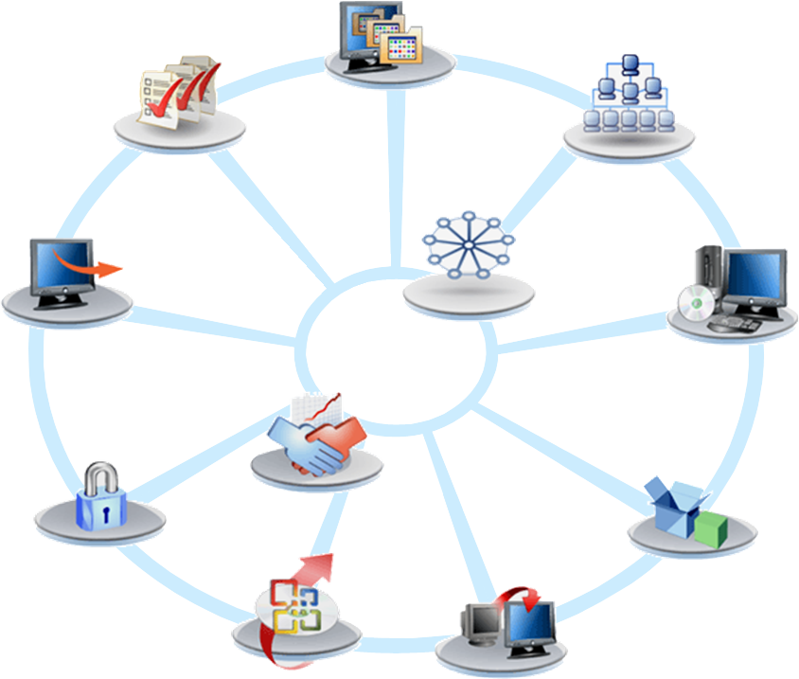
Microsoft Deployment
Testing Process
Operations
Readiness
Infrastructure
Remediation
Project
Process and
Team Guidance
Deployment
Process
Image
Engineering
Business Case
for Microsoft
Deployment
Security
Application
Management
Office
Deployment
Migration

Slide 16


What Is The Microsoft
Deployment Solution Accelerator?
End-to-end guidance, best practices, and tools for efficient planning, building, and deploying Windows and Microsoft Office
Based on real-world experience and industry best practices
Increase automation
Decrease costs
Manual Deployment
$500–$1000 per PC
Light Touch
~ $350 per PC
Zero Touch
Less than
$100 per PC

Slide 17
Microsoft Deployment
The tools
Microsoft Deployment can help…
Shows you how to use the new deployment tools together as part of an end-to-end deployment process
Provides tools and scripts to increase automation
and lower costs
Leverages and enhances other Microsoft tools
Simplifies the overall experience
Even the tools require guidance
  Things to watch out for, decisions that need to be made, possible alternatives

Slide 18
What’s new in Microsoft Deployment?
Microsoft System Center Configuration Manager 2007 support
Supports desktops and servers
Complete integration into the Configuration Manager 2007 admin console
  dynamic package installation
  automatic determination of state store location
  computer backup
Support for computers unknown to the Configuration Manager 2007 database
Added support for offline patching
Support for offline and online language pack installation
Deployment monitoring using Operations Manager 2007

Slide 19
What’s new in Microsoft Deployment?
Lite Touch Installation (LTI) enhancements:
Enhanced disk and NICs configuration options, including support for static TCP/IP configuration.
Design changes to ease the migration from LTI to Configuration Manager 2007.
Support for multiple task sequence templates. New sample templates include:
    Client template: Windows Vista, Windows XP
    Server template: Windows Server 2003, Windows Server 2008
    Replace scenario template
Ability to invoke web service calls
Support for BDD 2007 upgrade or side-by-side installation with Microsoft Deployment.

Slide 20
What’s new in Microsoft Deployment?
Lite Touch Installation (LTI) support for Windows Server 2008:
Support for deploying pre-release versions of Windows Server 2008
Support for Server Core installation options.
Automated server role definition using Server Manager
Lite Touch Installation (LTI) multicast support using Windows Deployment Services (WDS)

Slide 21
Scenario 3
Customer wants to ensure clients
and data are secure prior to deploying the new OS.

Slide 22
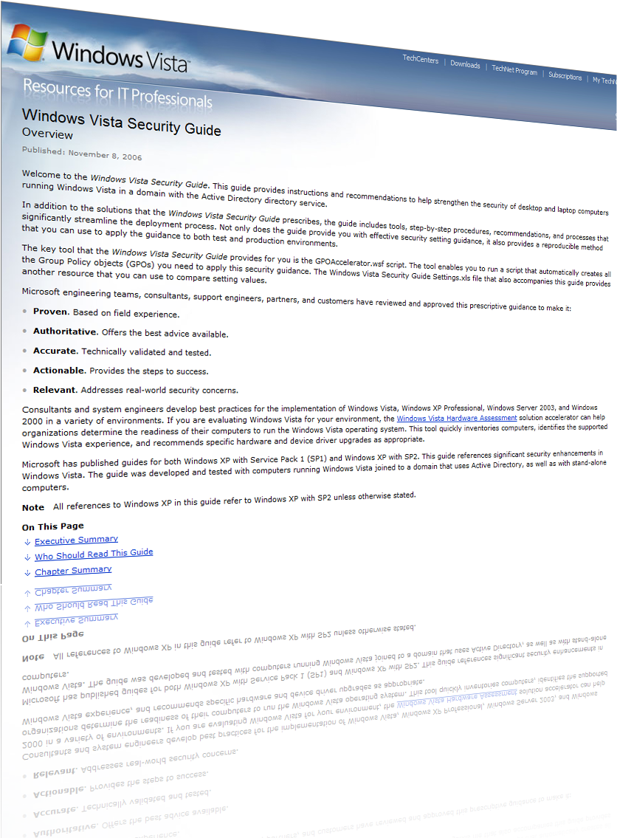
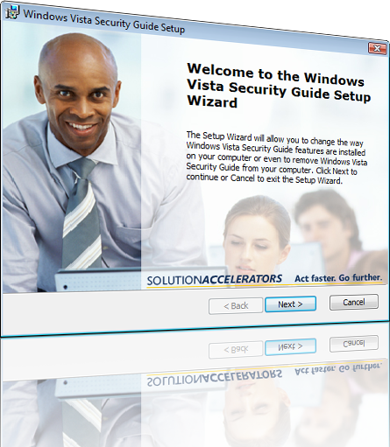
Windows Vista Security Guide
Unique GPO Accelerator tool deploys security configurations in
minutes versus hours
Best practices and automated tools to deploy Windows Vista security configurations
Preconfigured, customizable
security settings
Guidance is tested
by Windows Vista
Security Experts
SOLUTIONACCELERATORS Act faster. Go further.
microsoft.com/technet/SolutionAccelerators

Slide 23
The Guide Focuses On…
Defending against malware
  All types, from all sources
  Good protection that maintains usability
Protecting sensitive data
  Bitlocker, EFS, RMS, device control
  (e.g., USB drives)
Troubleshooting existing apps
(security settings)

Slide 24
What’s In The Guide?
Two tested security configurations
  Each with over 300 pre-set security settings
  Huge time saver for IT pros
GPOAccelerator Tool
  Automatically deploys chosen security configurations
Policy Definitions
  150 pages of detailed descriptions of Group
  Policy security settings (domain, computer, and
  user settings)
  Descriptions of each setting (enabled,
  disabled, #/value)
  What happens when you change them

Slide 25
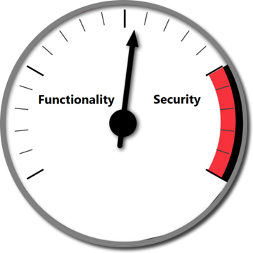
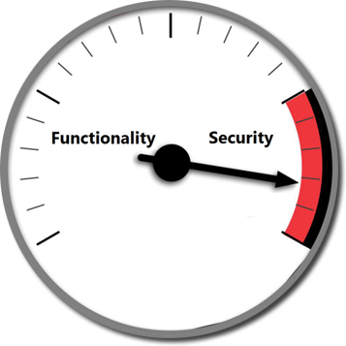
Two Baseline Security Configurations
Enterprise Client
  Balances security and functionality
  Used for most orgs
  Hardens Vista security right out of the box
Specialized Security Limited Functionality (SSLF)
  Much tighter security—at expense
  of functionality
  For orgs like intelligence
  agencies, military/government,
  financial institutions
  Or, used for groups where
  security is paramount

Slide 26
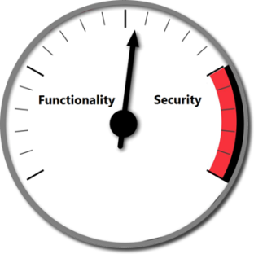
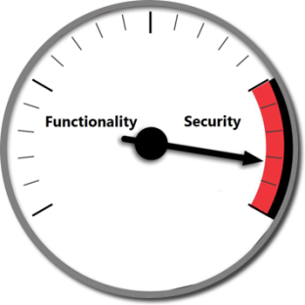
How The Vista Security
Guide Works
Choose right baseline config for risk posture
Enterprise Client?
Specialized Security—Limited Functionality?
Tailor preset configs
for your org
Defend against Malware
Protect sensitive data
Troubleshoot apps
Finish the job
Deploy to
test environment
Test!
Deploy tested settings
to production environment

Slide 27
Scenario 2 Continued
Now that the security is
defined, we can deploy.

Slide 28
Microsoft Deployment
demo
Jeremy Chapman
Solution Accelerators
Microsoft

Slide 29
Scenario 4
Customer wants to minimize TCO and properly manage the desktop service.

Slide 30



Service Management Concerns
What is the best way to balance objectives?
Increase Availability
and Utilization
Service
Levels
Lower Operational Costs
IT
Business Value
Cost Efficacy
Increase Responsiveness
Governance Compliance
Improve
Security

Slide 31

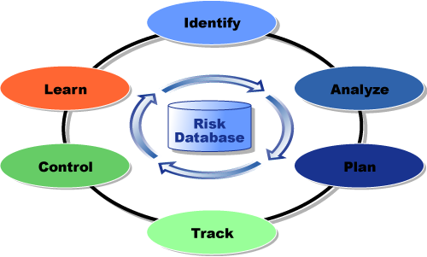
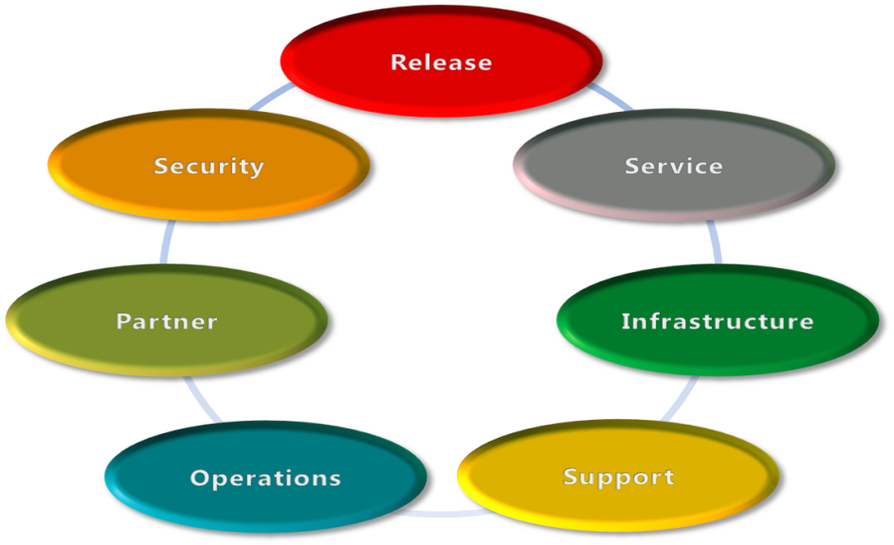
Microsoft Operations Framework
The three models
Process
Model
Risk
Model
Team
Model

Slide 32
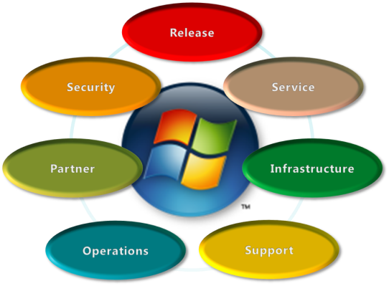
Windows Vista Service
Life-Cycle Management
Role-based guidance for the desktop service
IT Role | Guidance for
Service Mgmt | Enabling business through IT to meet organizational objectives
Security | Balancing organizational needs to protect and secure corporate resources with users’ needs to access IT resources
Infrastructure | Balancing IT’s capabilities against business requirements by designing and architecting an environment that addresses those needs
Release | Evaluating and deploying required changes to the environment with minimal business disruption
Operations | Ensuring the highly predictable execution of day-to-day tasks while optimizing the business’ return on investment (ROI)
Support | Providing timely resolution of incidents, problems, and inquiries while presenting the face of IT to end-users
Partner | Coordinating and managing the relationships with key partners to enable IT to deliver their objectives

Slide 33
End-To-End Guidance Spanning The Service Life-Cycle
Envision
Design
Build
Stabilize
and Deploy
Operate
and Support
Define the service concept
Identify requirements
Confirm approach
and resources
  Convert requirements to designs
  Create
  project plans
Develop of service plan
Build detailed test plans
Test user acceptance
Pilot deployment
Plan support
Perform production rollout
Day-to-day
care and feeding of systems
Perform ongoing change management
Deliver customer support
Drive continuous improvement processes

Slide 34
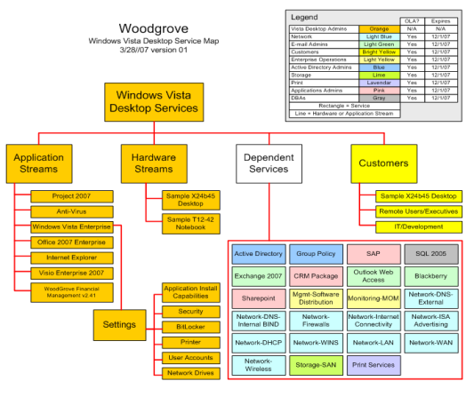
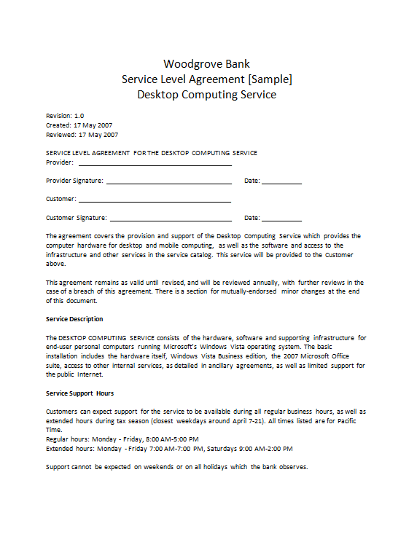
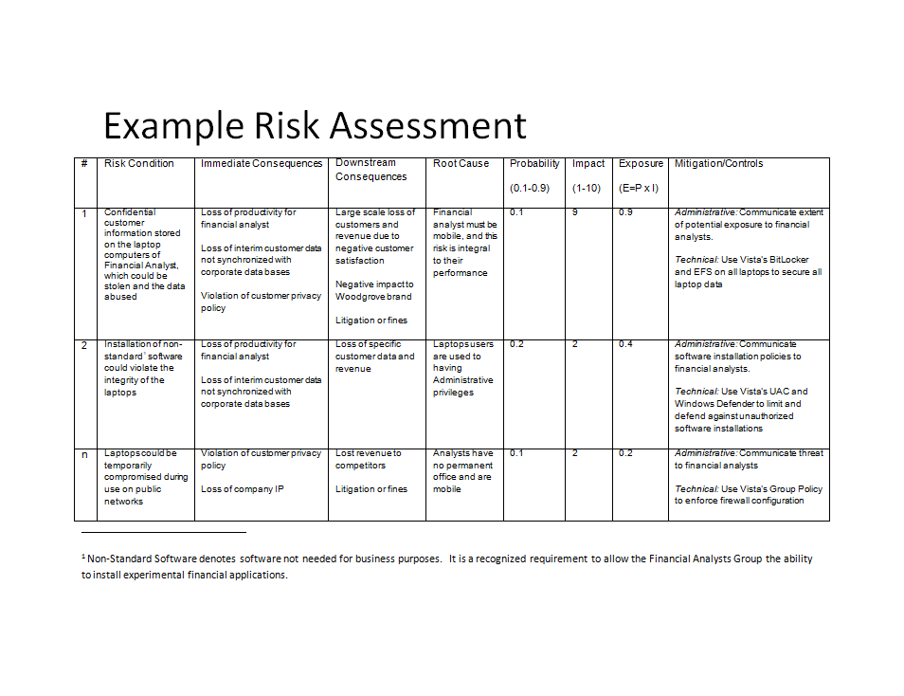
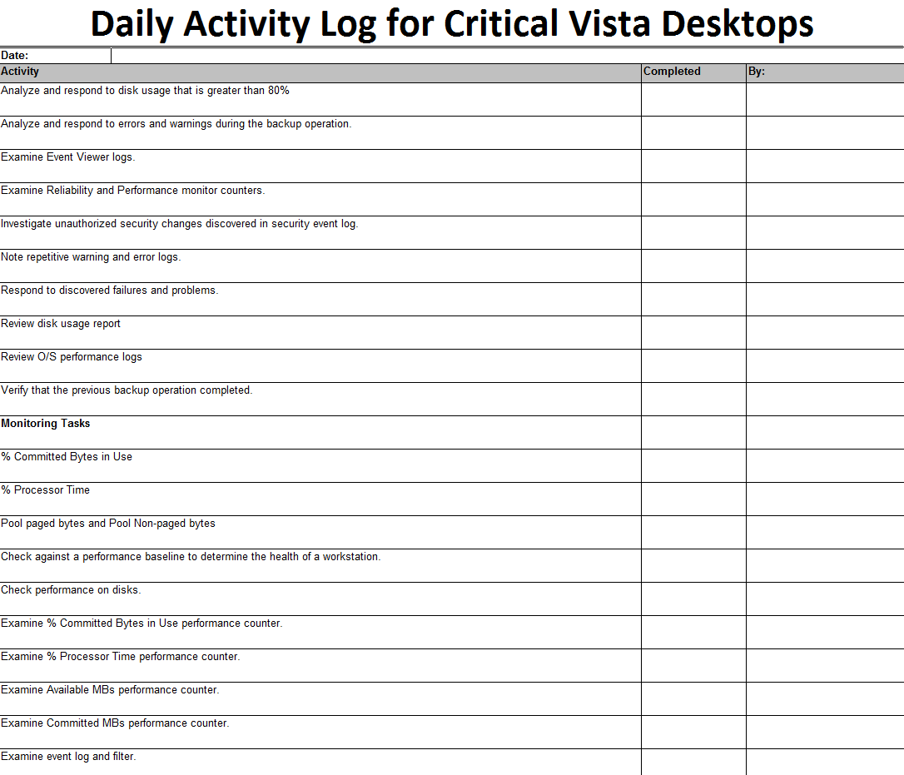
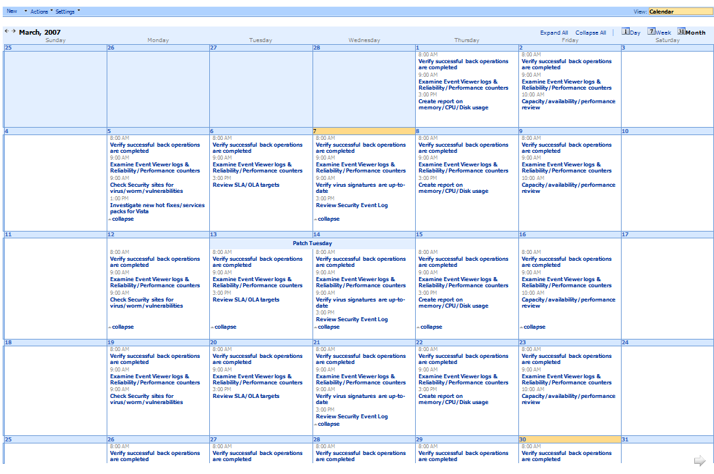
Overview Of Service
Life-Cycle Job Aids

Slide 35
Let’s Review
Service Management
Assess
Windows
Vista Service
Life-Cycle Management
Windows Vista Hardware
Assessment
Secure
Windows Vista Security Guide
and Data
Encryption Toolkit
Microsoft
Deployment
Deploy

Slide 36
Call To Action
Download the Windows Vista accelerators
View the entire catalog
microsoft.com/technet/SolutionAccelerators
Provide feedback
SATFeedback@microsoft.com
Related Windows Vista sessions
  CLI313 – Securing Windows Vista with Software and Device Restriction Policies
  CLI305 – BitLocker Drive Encryption
  CLI323 – Using Windows Vista Security Guide…
  CLI13-IS – Securing Windows Vista
  CLI302 – Accelerating Desktop Hardware Readiness Assessment…
  MGMT – How MOF moves ITIL v3 from Concept to Practice
  CLI308 – Microsoft Deployment and Configuration Manager 2007
  7 ILLs for Microsoft Deployment

Slide 37
Resources
Solution Accelerator Web Site
http://www.microsoft.com/solutionaccelerators
Windows Vista Hardware Assessment
http://www.microsoft.com/technet/wvha
Desktop Deployment Solution Center (including Microsoft Deployment and BDD 2007)
http://www.microsoft.com/desktopdeployment
Windows Vista Security Guide
http://www.microsoft.com/technet/windowsvista/security/guide.mspx
Data Encryption Toolkit for Mobile PCs
http://www.microsoft.com/det
Windows Vista Service Life-Cycle Management
http://www.microsoft.com/downloads/details.aspx?FamilyId=22950925-1DCD-4CA1-AF44-8DE987BA84E2&displaylang=en
Microsoft Learning and Certification
http://www.microsoft.com/learning/default.mspx
Microsoft TechNet
http://microsoft.com/technet
Trial Software and Virtual Labs
http://www.microsoft.com/technet/downloads/trials/default.mspx

Slide 38

Resources
Technical Communities, Webcasts, Blogs, Chats &
User Groups
http://www.microsoft.com/communities/default.mspx
Microsoft Learning and Certification
http://www.microsoft.com/learning/default.mspx
Microsoft Developer Network (MSDN) & TechNet
http://microsoft.com/msdn
http://microsoft.com/technet
Trial Software and Virtual Labs
http://www.microsoft.com/technet/downloads/trials/default.mspx
New, as a pilot for 2007, the Breakout sessions will be available post event, in the TechEd Video Library, via the
My Event page of the website
learn
support
connect
subscribe
TechNet Library Knowledge Base Forums TechNet Magazine Security bulletins User Groups Newsgroups
E-learning Product Evaluations Videos Webcasts V-labs Blogs MVPs Certification Chats
Visit TechNet in the ATE Pavilion and get a FREE 60-day subscription to TechNet Plus!

Slide 39
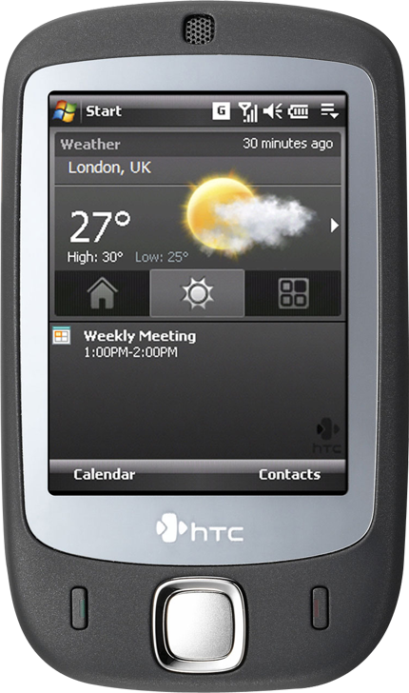



Complete your evaluation on the My Event pages of the website at the CommNet or the Feedback Terminals to win!
All attendees who submit
a session feedback form within 12 hours after the session ends will have the chance to win the very latest HTC 'Touch' smartphone complete with Windows Mobile® 6 Professional

Slide 40


© 2007 Microsoft Corporation. All rights reserved.
This presentation is for informational purposes only.
MICROSOFT MAKES NO WARRANTIES, EXPRESS OR IMPLIED, IN THIS SUMMARY.

