Slide 1
CLI319
Windows Vista Application Compatibility Tools and Resources
Peg McNicol
Product manager, Windows Client
Chris Jackson
Senior consultant and technical lead, AE SWAT team

Slide 2






Getting Started with Enterprise Application Compatibility
Assess your current environment
Gather a hardware and software inventory
Identify the critical resources in your organization
Plan your work
Accidental architecture or architecture by design

Slide 3

Application Management Infrastructure Optimization Model
Basic
Cost Center
Standardized
More Efficient Cost Center
Rationalized
Business Enabler
Dynamic
Business Asset
Limited or ad-hoc application testing
Application quality standards vary
Application lifecycle not managed
Application installation tools vary
Limited or ad-hoc sharing of application issues and solutions
Defined set of test tools and recommendations
Quality standards exist but release criteria vary
Broad categories of applications exist and portfolio is centralized
Multiple systems for centralized deployment exist
Issues/solutions reported on multiple central systems
Scripted test plans and automated tests
Quality standards exist with ad-hoc tests
Applications categorized and reviewed regularly
Standard workflow for deployment defined
Issue/solution data captured from various sources with clear escalation paths
Automated application tests easily used and updated
Standard application certification program
Managed redundancy upgrades and end of life – gaps identified
Automated workflow for rapid deployment
Issue/solution data captured - tied to tools and training plans

Slide 4
The Phases of Application Management in Deployment
Collect
Test and Mitigate
Analyze

Slide 5



Before you start

Slide 6
Gathering an Application Inventory
Managed or unmanaged
Centralized or autonomous IT Department
Available Inventories and tools
Scope
Then – Manual or Automated inventory
Static or dynamic analysis
How many machines you actually need to inventory, and which ones?

Slide 7
Analyzing Application Compatibility Data
Relevance
Multiple versions
Roles
Who is using the application
Priority
High Priority
Similar functionality
Limited use
Better tools now available – possibly included in other applications
Limited future development
user group
deployment group
region
department
Important
Optional

Slide 8
Putting together your plan
Resources
Budget
Team
Infrastructure

Slide 9
Next Steps
Identify your toolbox
Do you want to use virtualization
What level of support are you comfortable with
Is it different for your ISV apps vs your in-house custom apps

Slide 10
Tools

Slide 11
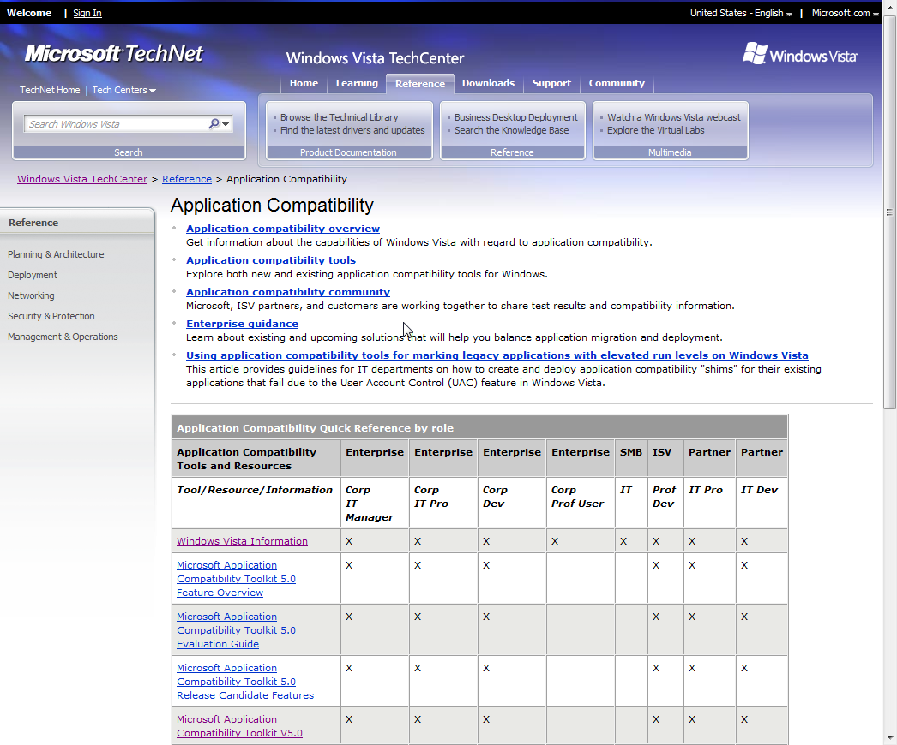
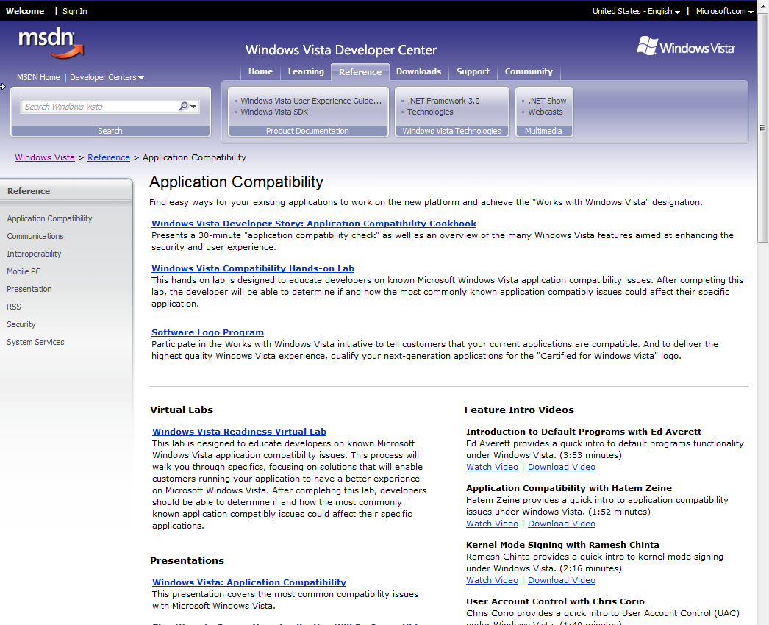
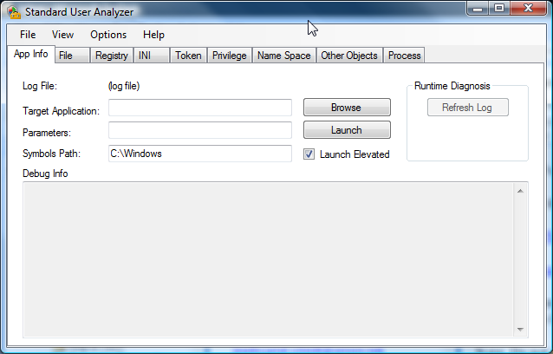
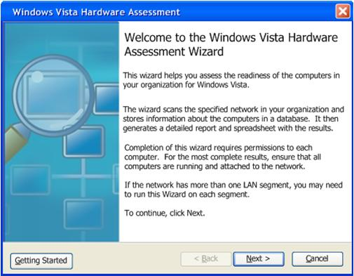
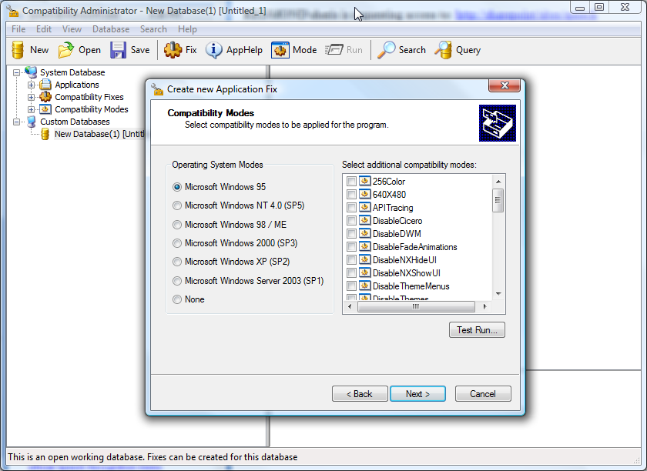
Readying the Enterprise
Rich Developer and Tester Tools and Information
  Microsoft Deployment Accelerators
  Application Compatibility Toolkit
    Application Compatibility Manager
    Compatibility Administrator
    Standard User Analyzer
    Set Up Analysis Tool
    IE 7 Test Tool
  Windows Vista
  Hardware Assessment
  Developer Cookbook
  TechNet Guidance

Slide 12
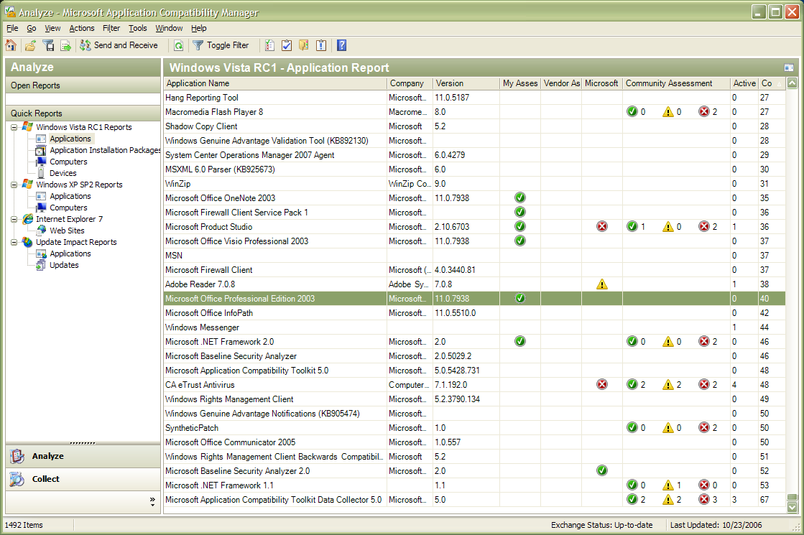
Application Compatibility Toolkit 5.0
  Single environment to help detect, diagnose, and mitigate compatibility issues found in Windows Vista
  Microsoft Compatibility Exchange to facilitate exchange of compatibility data between ISV/IHV, Microsoft, and customers
  Available Compatibility Evaluators include:
    Inventory collector,
    User Account Control,
    Windows Vista specific
      Deprecations
      GINA
      Session 0
      Internet Explorer

Slide 13
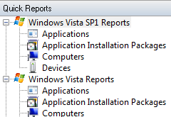
Application Compatibility Toolkit 5.0
Application Compatibility Toolkit 5.02
  Available November 2007
  SP1 Reporting Node
  .NET 2.0
  DCP → MSI
  MSXML eliminated
  Shim improvements
  Filter by domain
  Passport

Slide 14
Demo
Application Compatibility Toolkit 5.02

Slide 15
Resolving Issues
Fixing the Code
Shims
Modifying policy / security / ACLs

Slide 16
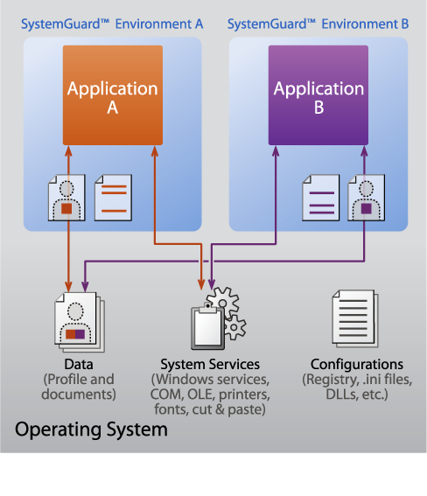
Microsoft SoftGrid Application Virtualization
Applications are virtualized per instance
  Files (incl System Files)
  Registry
  Fonts
  .ini
  COM/DCOM objects
  Services
  Name Spaces
  Semafores, Mutexes
Applications do not get installed or alter the operating system
Yet Tasks process locally on the host computer

Slide 17
Virtualization / Remote Desktop
Resolve issues by simply running down-level
Virtual PC, Virtual Server
  Scripting option for Virtual Server
UX issues, stopgap solution

Slide 18




Next Steps
  Read the White Papers www.technet.microsoft.com/appcompat
  Think about your team and resources
  Download the tools
  Start Initial Application Compatibility Testing
  with Compatibility Toolkit (ACT)
  Assess your desktop infrastructure maturity
Notes:
18

Slide 19
Windows Vista Enterprise Application Compatibility
Resources
  Application Compatibility for IT Professionals
    Application Compatibility Toolkit
    IT Pro White Papers and resources
    Windows Vista Hardware Assessment
    Application Compatibility Training
    Resources and references for the IT Pro
    http://technet.microsoft.com/appcompat
  Application Compatibility Cookbook
    http://msdn.microsoft.com/appcompatcookbook
  Application Readiness Site
    http://www.appreadiness.com
  Microsoft Desktop Deployment Tools
    www.microsoft.com/desktopdeployment

Slide 20
Q&A
Name
Title
Group

Slide 21

Resources
Technical Communities, Webcasts, Blogs, Chats &
User Groups
http://www.microsoft.com/communities/default.mspx
Microsoft Learning and Certification
http://www.microsoft.com/learning/default.mspx
Microsoft Developer Network (MSDN) & TechNet
http://microsoft.com/msdn
http://microsoft.com/technet
Trial Software and Virtual Labs
http://www.microsoft.com/technet/downloads/trials/default.mspx
New, as a pilot for 2007, the Breakout sessions will be available post event, in the TechEd Video Library, via the
My Event page of the website
learn
support
connect
subscribe
TechNet Library Knowledge Base Forums TechNet Magazine Security bulletins User Groups Newsgroups
E-learning Product Evaluations Videos Webcasts V-labs Blogs MVPs Certification Chats
Visit TechNet in the ATE Pavilion and get a FREE 60-day subscription to TechNet Plus!

Slide 22
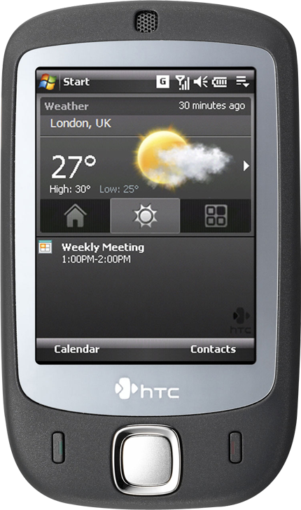



Complete your evaluation on the My Event pages of the website at the CommNet or the Feedback Terminals to win!
All attendees who submit
a session feedback form within 12 hours after the session ends will have the chance to win the very latest HTC 'Touch' smartphone complete with Windows Mobile® 6 Professional

Slide 23


© 2007 Microsoft Corporation. All rights reserved.
This presentation is for informational purposes only.
MICROSOFT MAKES NO WARRANTIES, EXPRESS OR IMPLIED, IN THIS SUMMARY.

Slide 24
Appendix

Slide 25

Budgeting
Application Compatibility
  Note From Field: Wildly inaccurate estimations floating around
  “Rules of thumb”
    8 hours an application???
    3 – 30 weeks at x rate per week
  It depends
    Will applications be declared “end of life”?
    Will virtualization be used?
    Will experts be engaged?
    Will an Application Compatibility Factory partner be engaged?
  Most accurate method – estimate after a pilot
    Deploy ACT
    Identify 20 to 30 typical applications
    Engage experts to train and remediate
    Extrapolate from there
  “Cone of Estimation” vital for accurate determination
Notes:
© 2006 Microsoft Corporation. All rights reserved.
This presentation is for informational purposes only. Microsoft makes no warranties, express or implied, in this summary.

Slide 26


Planning for Application Compatibility
3,000
1,000
500
Organize your application portfolio to understand the real scope of your application compatibility efforts
  Analyze – Use ACT to inventory and help eliminate noise (operating system applications, games, etc.)
  Rationalize – Consolidate and rationalize remaining applications. Use the organization and filtering features of ACT
  Prioritize – Categorize as mission critical, important, departmental, etc., and focus efforts
Use ACT to organize and plan your migration scenario
After Analyzing
After Rationalizing
After Prioritizing
Notes:
© 2006 Microsoft Corporation. All rights reserved.
This presentation is for informational purposes only. Microsoft makes no warranties, express or implied, in this summary.

